Slide 1
THE INTERNAL & EXTERNAL ENVIRONMENTS

Slide 2
Lecture outline
External environment
Types of external environment
Analysing the environment
Managing the environment
Internal environment (culture)
Nature of organisational. culture
Manifestations of culture
Promoting innovation
Changing organisational. culture
Leadership & cultural change

Slide 3
External environment
‘Major forces outside the organisation with potential to influence significantly a product or service’s likely success.’

Slide 4
External environment
External environment is made up of:
The Mega-environment
The broad conditions and trends in societies in which an organisation operates.
The Task environment
Specific outside elements with which an organisation interfaces in the course of conducting its business.

Slide 5
The Mega-environment
Economic element
Technological element
Legal–political element
The organisation
International element
Sociocultural element

Slide 6
The Mega-environment
Five major elements:
Technological element
Current state of knowledge regarding production of products & services.
Economic element
Systems of producing, distributing & consuming wealth.
Legal-political element
Legal & governmental systems within which an organisation must function.

Slide 7
The Mega-environment
Socio-cultural element
Attitudes, values, norms, beliefs, behaviours & associated demographic trends characteristic of a given geographic area.
International element
Developments in countries outside of an organisation’s home country with potential to influence the organisation.

Slide 8
The Task environment
Competitors
Government & regulators
Customers
/clients
The Organisation
The
employment market
Suppliers
Public pressure groups

Slide 9
The Task environment
Five elements:
Customers and clients
Individuals and organisations purchasing products/services.
Competitors
Other organisations either offering (or a high potential of offering) rival products/services.
Suppliers
Organisations and individuals supplying resources an organisation needs to conduct its operations.

Slide 10
The Task environment
Labour supply
Individuals potentially employable by an organisation.
Government agencies
Agencies providing services and monitoring compliance with laws and regulations at local, State or regional and national levels.

Slide 11
Analysing the environment
Perspectives on environment:
Population ecology model
Argues that environmental factors cause organisations to survive or fail.
Resource dependence model
Highlights the dependence of organisations on environment but attempt to manipulate the environment to reduce this dependence.

Slide 12
Analysing the environment
Environment characteristics:
Uncertainty
Condition in which future environmental circumstances affecting an organisation cannot be accurately assessed and predicted.
Complexity
Number of elements in an organisation’s environment and their degree of similarity.

Slide 13
Analysing the environment
Dynamism
Rate and predictability of change in the elements of an organisation’s environment.
Bounty
Extent to which the environment can support sustained growth and stability.

Slide 14
Managing the environment
Three approaches to managing the environment:
Adaptation
Involves changing internal operations & activities to make the organisation and its environment more compatible.
Favourability influence
Involves trying to alter environmental elements to make them more compatible with the organisation’s needs.
Domain shifting
Changing product/service mix to create favourable interface.

Slide 15
Adaptation
Buffering
Stockpiling either inputs into or outputs from a production or service process to cope with environmental fluctuations.
Smoothing
Taking actions aimed at reducing the impact of fluctuations, given the market.
Forecasting
Predicting changing conditions & future events that significantly affect an organisation’s business.
Rationing
Providing limited access to a product or service in high demand.

Slide 16
Favourability influence
Advertising & public relations
Boundary spanning
Recruiting
Negotiating contracts
Co-opting
Strategic alliances
Trade associations
Political activity

Slide 17
Domain shifting
Move out of a current product, service or geographic area into a more favourable domain
Expand current domains through diversification or expansion of products/services offered

Slide 18
Internal environment
Nature of organisational culture:
‘A system of shared values, assumption, beliefs and norms uniting organisational members’ (Smircich 1983; Kilman
et al. 1986).
‘The way we do things around here.’
The ‘glue’ binding the disparate parts (or the oil that keeps them moving).
The interpretive part of organisational behaviour: It explains, gives direction, sustains energy, commitment, and cohesion.

Slide 19
Manifestations of culture
Symbols
Object, act, event or quality serving as a vehicle for conveying meaning.
Stories
Narrative based on true events, which may be embellished to highlight intended value.
Rites
Relatively elaborate, dramatic, planned set of activities intended to convey cultural values to participants and, usually, an audience.
Ceremonies
System of rites performed in conjunction with a single occasion or event.

Slide 20
Promoting innovation
Strategic
Focussed on identifying opportunities.
Committed to seizing opportunities
Willing to make major, fast changes.
Commitment of resources
Many stages with risk assessed for each stage.
Control of resources
Rental or outsourcing of resources for flexibility.
Management structure
Few levels with informal communication.

Slide 21
Changing organisational culture
Because they involve fairly stable values,
assumptions, beliefs & norms, organisations can
be difficult to change.
An approach to changing culture:
Surfacing actual norms
Articulating new directions
Establishing new norms
Identifying culture gaps
Closing culture gaps.

Slide 22
Leadership and cultural change
Crisis identification
Communication of a new vision
Motivation of key staff to lead cultural change by implementing the new vision and its corresponding strategy

Slide 23
Lecture summary
External environment:
Types of external environment
Mega environment; Task environment
Analysing the environment
Models: Ecology & Resource dependence
Managing the environment
Adaptation, Favourability influence & Domain shift

Slide 24
Lecture summary
Internal environment (culture):
Nature of organisational culture
System of shared values, assumption, beliefs and norms uniting organisational members.
Manifestations of culture
Symbols, stories, rites and ceremonies.
Promoting innovation
Requires strategically oriented organisations with ability to change quickly.

Slide 25
Lecture summary
Internal environment (culture):
Changing organisational culture
Difficult because of need to change values & behaviour.
Leadership & cultural change
Leaders convey need for change, provide new vision & motivate key staff.

Slide 26
Why do Businesses Fail?

Slide 27

Why Do Businesses Fail?
Reasons for failure are usually more obvious than reasons for business success…
a) Lack of skill / knowledge
b) Expanding too quickly
c) Lack of capital
d) Inability to stay competitive

Slide 28
Lack of Skill or Knowledge
High school and post secondary business courses
Experience in business
Business failure often results from:
1) Poor marketing
2) Poor accounting
Notes:
Business courses in high school and College/University as well as experience working in business all provide some of the skills necessary to run a business.
It is unrealistic to assume that without business skills (education and experience) you can operate a successful business. It would be like asking a person who has never learned to be an electrician to wire your house. Or asking someone’s medical opinion who has never been to medical school.
Poor marketing is when you cannot get your product out to the consumers
Poor accounting is when you are spending to much money on inventory and too much money on expenses

Slide 29
Marketing experts:
- good at promotional ideas
- creative advertising
- colorful & eye catching displays
- predict demand
- spot trends & fads
- appreciation for product design/package graphic
- good customer service
Notes:
Good marketers know how to reach the customers and they know how to talk to them

Slide 30
Accountants
- set budgets
- Buying Quotas: limits on the amount of money a business should spend on inventory
- negotiate terms
- pay invoices on time
- keep financial records
- make sure a business is profitable
Notes:
The major goal of an accountant is to make sure a business is profitable.
A great example of exceptional marketing but poor accounting is a restaurant owner spending so much money on the décor of the restaurant, and even though the restaurant is beautiful, cots were so high that the restaurant could not make a profit and failed after its first year.
An example of a restaurant with a balance of marketing and accounting is Cactus Club Restaurants, they just started putting a lot more money into the décor of their restaurant, they also hired a celebrity chef to run the culinary aspect of the business but this only happened in the last 4 years but Cactus Restaurants have been open for years.

Slide 31
Expanding too Quickly
Expansion, developing new products, franchise or acquire others businesses
Decisions need to be based on research
Businesses that become successful so fast may try to grow too quickly without analyzing expansion plans
Forgetting your origins can cause businesses financial difficulty
Some businesses are so large that change happens very slowly
Notes:
Many successful businesses decide to expand, develop new products or distribution channels, franchise, or aquire other businesses. If these decisions are based on thorough research and are financially responsible, they will often make a business more profitable by opening up to new markets. However, some businesses become so successful so fast that they try to grow too quickly without analyzing their expansion plans. For example, take a business who has a single retail location because the store was very successful the owners thought to expand to a number of different locations and cities because of the quick expansion the concept of the store changed and was not as popular as it once was. Even though money was coming in, it was not enough to pay of the costs of expansion and the company went bankrupt.

Slide 32
Lack of Capital
Running out of money is often a result of failure to budget properly
It is recommended that you have one year of operating expenses in reserve when going into business
Initial capital from → personal savings, bank loans, investors, partners, friends and family.
If a business is profitable revenue from sales will eventually cover the operating costs.
Notes:
Sometimes businesses have the ability to be successful but owners do not understand the importance of being properly financed. If a business is under-financed and it does not have enough money to carry through the start-up, the business will fail even if it has the potential to be successful.

Slide 33
Business Growth

Slide 34
DYNAMICS OF GROWTH
Financial Growth
Resources
Performance
Strategic Growth
Asset accumulation
Direction
Structural Growth
Organisational Growth
Use of assets
(Wickham 2001:304)

Slide 35
Eight characteristics of growing organisations
Market domination – measured in terms of relative market share in a niche market, it differentiates between good and poor performance
Differentiation – uniqueness through being different from competitors
Product leadership
Flexibility – the speed and ability to gain advantage from
new opportunities
Innovation
Future orientated
Export
Related growth – successful businesses strive for active cognisant growth as opposed to uncontrolled growth.

Slide 36
Critical success factors for growth
Market intelligence – to be able to perceive and adapt to market changes, including future trends, competition and customer feedback
Strategic leadership – to provide clear direction,
delegation and decision-making.
Clarity of purpose and direction – to have vision and a shared understanding of the uniqueness and identity of the business
Strategic planning
Internal infrastructure – to be able to support the business through internal systems and structures.

Slide 37
Growth is a process that poses challenges to the organisation
Financial implications of growth – the act of conducting
business requires cash, so that the financing requirement must be recognized.
Management and control issues – a growing organization places a burden on functional capacity. There must be formality, consistency and routine.
Marketing and operations implications – growth often occurs through either a production orientation or a marketing orientation. As the business grows, conflict between these two functions becomes likely.
Biological implications • - the advance of years raises issues of
succession
Organisational implications – a growing business requires more people and more managers and has to be flexible and adaptable.

Slide 38
Business Cycle Phase

Slide 39
Business Cycle Phases
Expansion
Recession
Expansion
Boom
Peak
Upturn
Downturn
Total Output
Secular growth trend
Trough
0
Jan.-
Mar
Apr.-
June
July-
Sept.
Oct.-
Dec.
Jan.-
Mar
Apr.-
June
July-
Sept.
Oct.-
Dec.
Jan.-
Mar
Apr.-
June

Slide 40
Why Do Business Cycles Occur
Recessions and expansions are caused primarily by demand-side shocks.
A debate exists about whether these fluctuations can and should be reduced.

Slide 41
Why Do Business Cycles Occur
Most economists believe that potential depressions should be offset by economic policy.
This general view was built into economics in the Great Depression of the 1930s.

Slide 42
Why Do Business Cycles Occur
During this period there were changes in the economy's structure, with government playing a much more active role.

Slide 43
Leading Indicators
Leading indicators are a set of signs that indicate what is likely to happen 12 to 15 months from now.

Slide 44
Leading Indicators
Variables that make up the leading indicator include:
  Average workweek for production workers in manufacturing.
  An index of housing starts.

Slide 45
Leading Indicators
Variables that make up the leading indicator include :
  The money supply M1 divided by the price index.
  New orders for durable goods.
  Retail trade in furniture and appliances.
  Durable goods sales excluding furniture and appliances.

Slide 46
Leading Indicators
Variables that make up the leading indicator include:
  The ratio of shipments to inventories or finished products.
  The stock price index.
  Employment in business and personal service sector.

Slide 47
Leading Indicators
Economists use indicators in making forecasts about the economy. They are indicators, not predictors.

Slide 48
Business Cycle
In this lesson, students will be able to identify characteristics of the business cycle.
Students will be able to identify and/or define the following terms:
Business Cycle
Expansion
Peak
Contraction
Trough

Slide 49
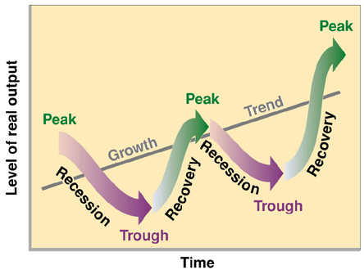
A business cycle is a period of macroeconomic
expansion followed by a period of contraction.

Slide 50
The Four Phases of a Business Cycle
There are four phases in a business cycle:
Expansion: a period of economic growth
Peak: the height of the expansion
Contraction: a period of economic decline
Trough: the lowest point of the contraction

Slide 51

When an economy
is expanding or
growing, many people
have jobs and many
goods and services
are being produced
and sold. At the peak
of the expansion,
Gross Domestic Product
is as high as it will
go for that particular
business cycle.

Slide 52
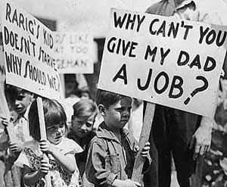
During a
period of
contraction,
more people
are unemployed
and fewer goods
and services are
being produced
and sold. Not
all contractions
are equally
severe.

Slide 53
Recessions and Depressions
Each phase of the business cycle is determined by monitoring Gross Domestic Product.
A contraction that lasts for at least six months is called a recession.
A particularly severe and long contraction is called a depression.

Slide 54

The Great
Depression
was the most
severe economic
contraction in the
history of the
world. It
permanently
changed the way
economists think.

Slide 55
Factors Which Affect the Business Cycle
The following four factors can affect the business cycle:
Investment in Businesses
Interest Rates
Consumer Expectations
External Shocks

Slide 56
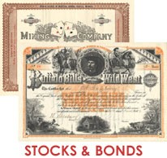
The more money people invest in businesses,
the more money businesses have to grow.
Investment affects the business cycle.

Slide 57

Interest is the price of borrowed money. When
interest rates are high, people borrow less.
Businesses borrow less too.
Interest rates affect the business cycle.

Slide 58
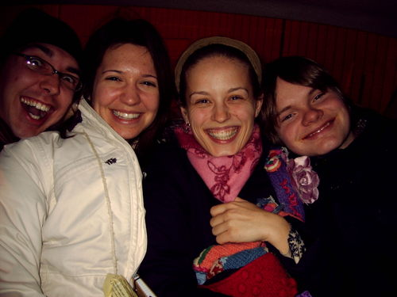
When people are optimistic about the future,
they spend more money. Optimism affects
the business cycle.

Slide 59
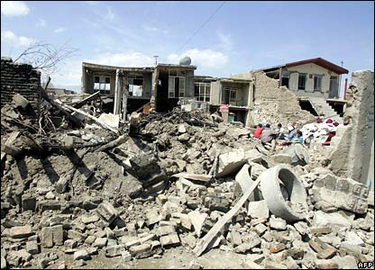
External shocks can be positive or negative.
An earthquake is a negative external shock.
It affects the business cycle.

Slide 60
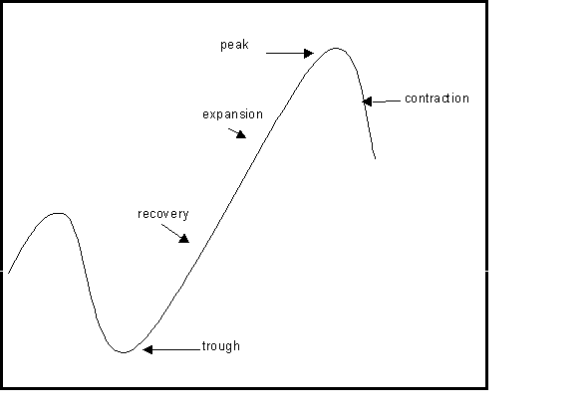
Throughout history, there have been
many business cycles.

Slide 61
BUSINESS LIFE CYCLE

Slide 62
WHAT IS THE BUSINESS LIFE CYCLE?
The BUSINESS LIFE CYCLE is a series of
STAGES that a product goes through from
when a business first creates and sells it
until the time nobody wants it any more.

Slide 63
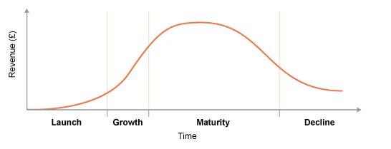
BUSINESS LIFE CYCLE STAGES
The Businesslife cycle diagram shows that four stages exist
in the ‘working life’ of most products.

Slide 64
STAGE 1
Costly stage as lots of advertising and promotion is needed to encourage sales.
SALES will start to RISE SLOWLY as people become aware of the product.
PROFITS will start to APPEAR SLOWLY as sales rise and start up costs are repaid

Slide 65
STAGE 2 - GROWTH
SALES will start to RISE QUICKLY as many people begin to use the product.
PROFITS will start to RISE QUICKLY as sales rise sharply.

Slide 66
STAGE 3 - MATURITY
SALES will start to SLOW DOWN as almost everyone who wants the product will have it.
PROFITS will be MAXIMISED as the maximum number of sales is made.

Slide 67
STAGE 4 - DECLINE
SALES will start to FALL as people start to use other better or newer products.
PROFITS will start to FALL as sales fall.
At this stage a decision has to be made
about whether to withdraw the product
or use extension strategies to inject new
life into the product.

Slide 68
Extension Strategies
The marketing mix can be changed to inject
new life into a product by:
Changing or modifying the PRODUCT
Altering the distribution pattern (PLACE)
Changing the PRICE
Using a new PROMOTIONAL campaign
These methods can delay the replacement or
withdrawal stage for some time

Slide 69
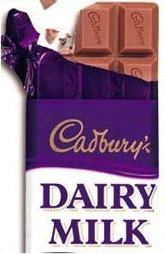
LIFE CYCLE VARIATIONS
The speed at which different products move
through the life cycle will vary, and some
never seem to complete their life cycle at all
eg Cadbury’s Dairy Milk was introduced in
1905 and is still going strong!
This tends to be because the product has a
strong brand and a loyal customer base.

